Slide 1





Sunday 3/9/2023
MV. P. 20,21
Reading Booklet 12- 13

Slide 2
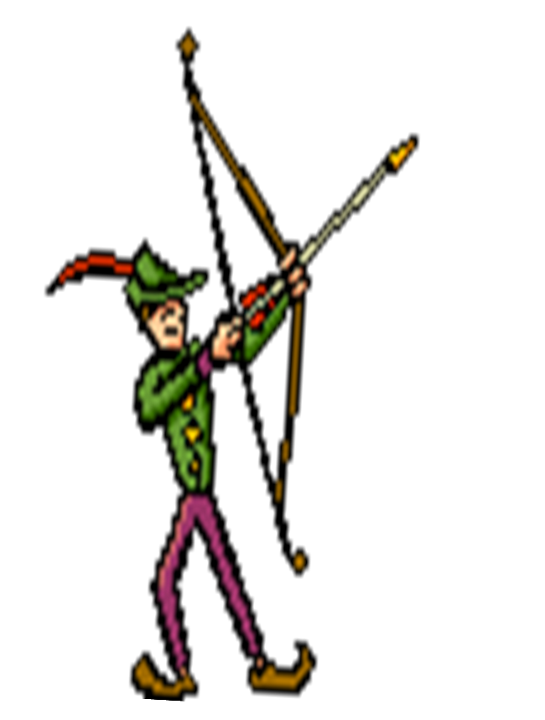
Learning Objectives
By the end of this lesson , students will be able to:
Identify and define elements of a story
Identify realistic fiction story by deciding whether the characters and setting are real-like people and places.

Slide 3
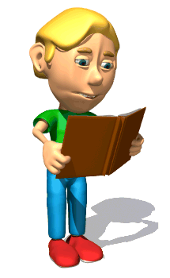
Elements
of a
Story
Notes:
3

Slide 4
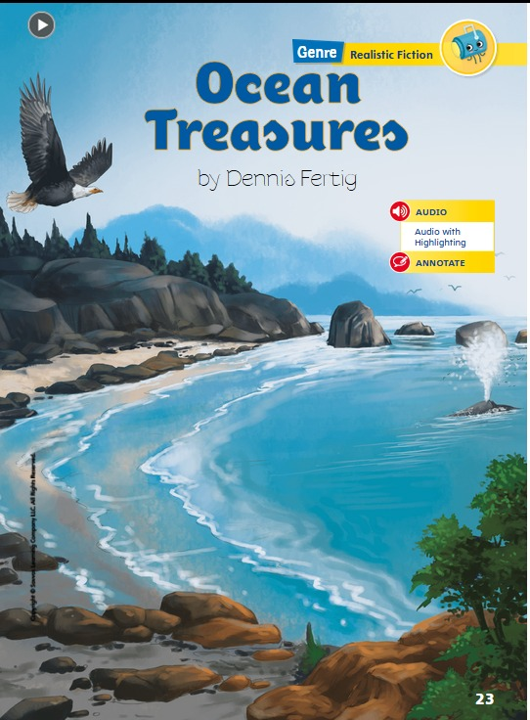

Slide 5
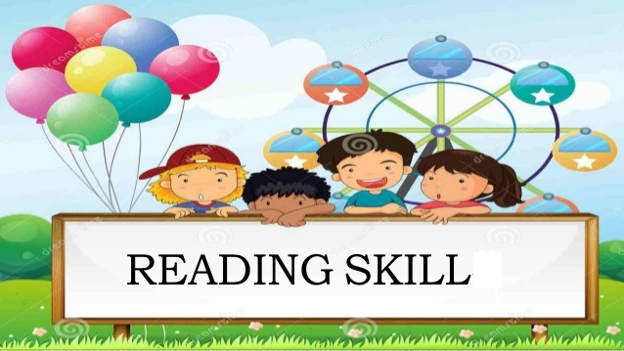


Slide 6
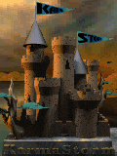
Overview
A Short Story is similar to your dish. It needs the best ingredients for you to enjoy its delectable taste.
Stories are made up of three important elements:
Setting
Characters,
and plot
Elements of a Short Story
Notes:
6

Slide 7
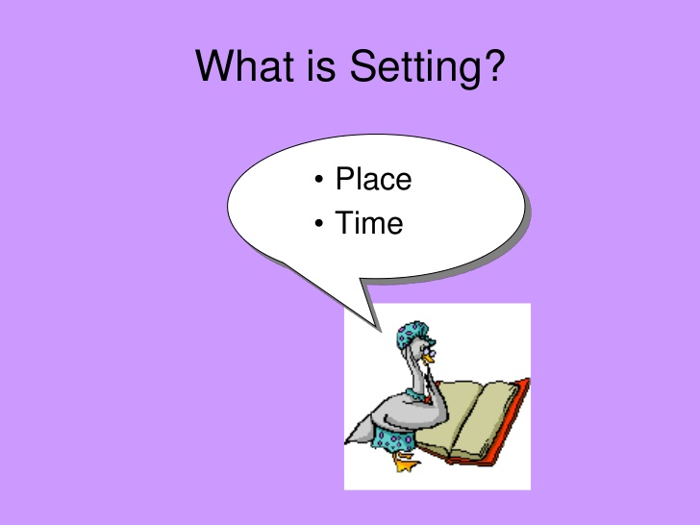

Slide 8

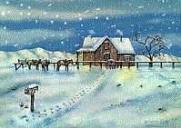
Elements of a Story
Setting
Tells the reader where and when the story takes place.

Slide 9
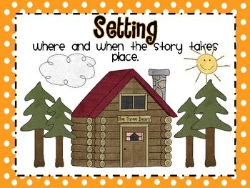

Slide 10
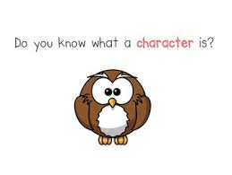

Slide 11
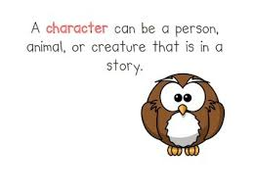

Slide 12
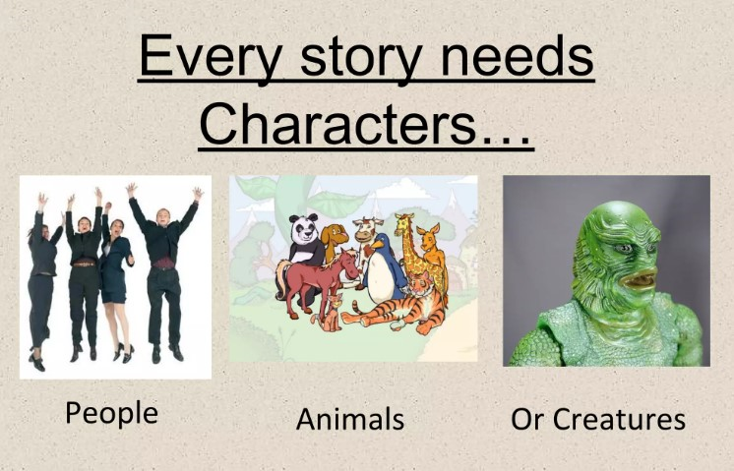

Slide 13
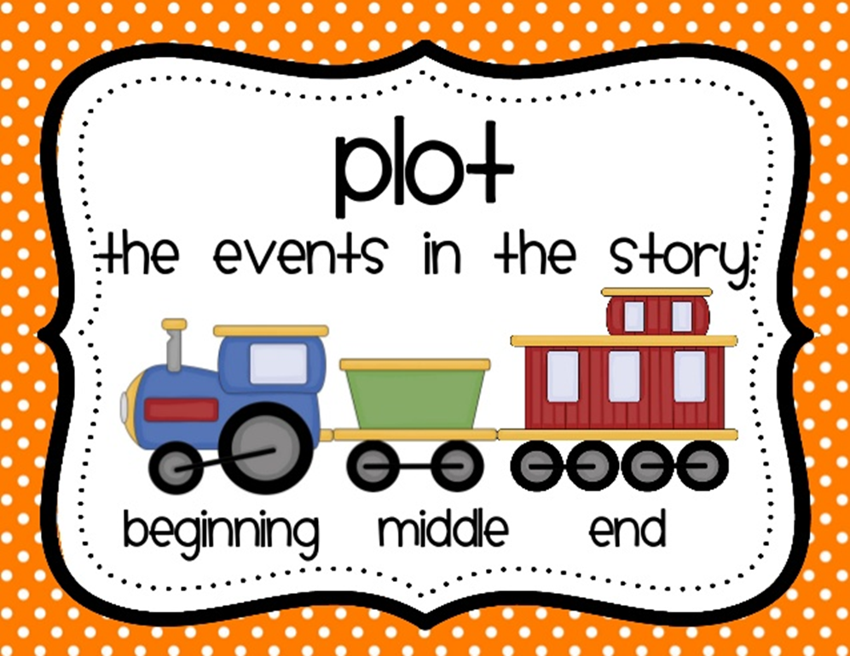

Slide 14
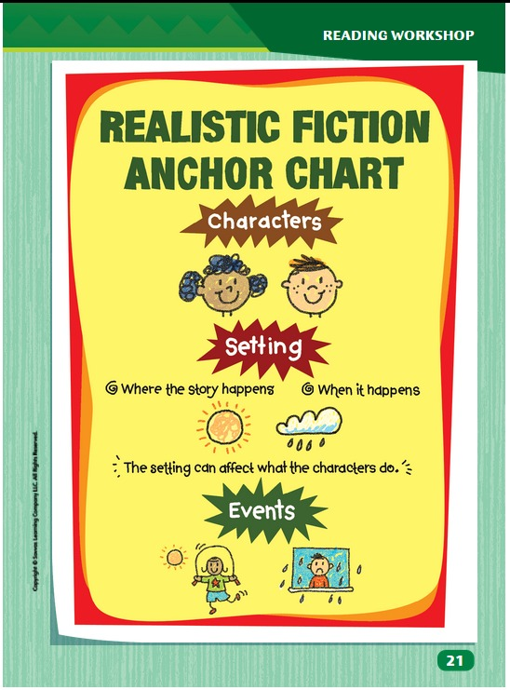

Slide 15
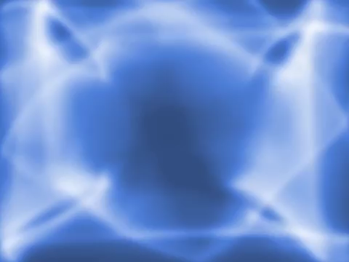

Slide 16


Slide 17
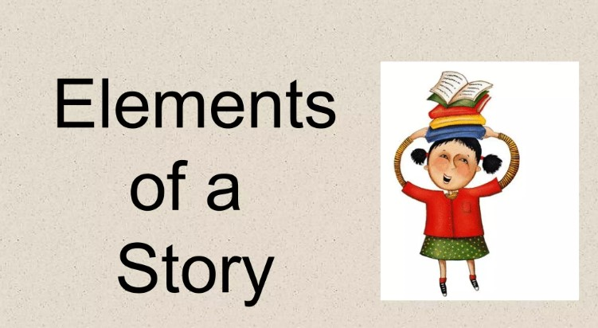

Slide 18
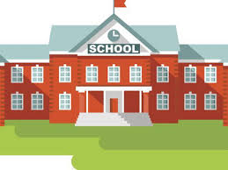
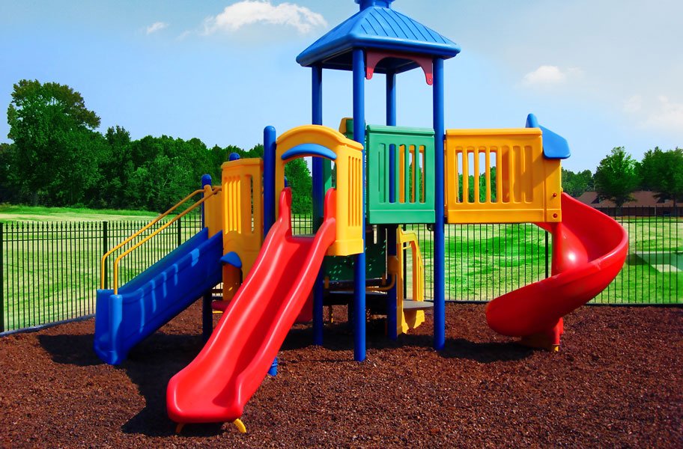
What is the setting in the following pictures?
At the park
In the morning
At the school.
In the morning.

Slide 19
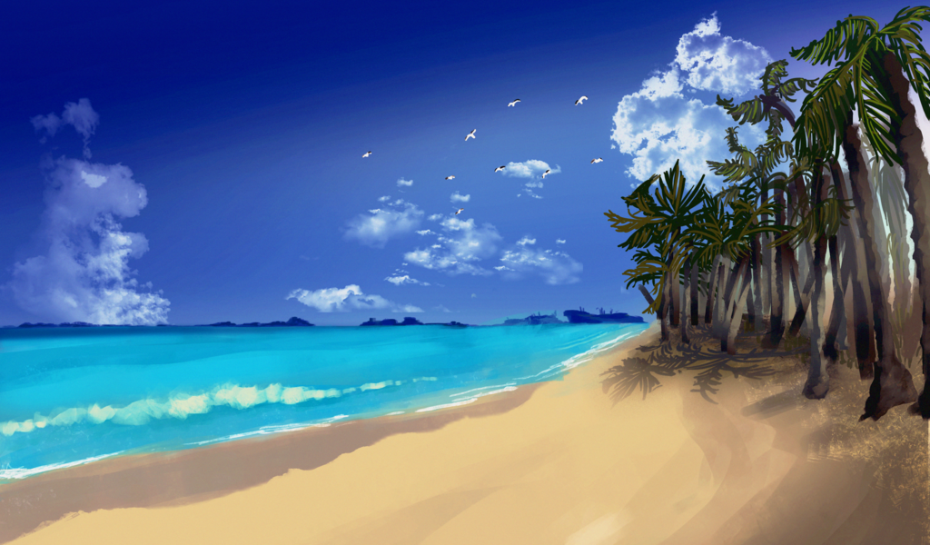
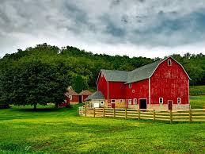
What is the setting in the following pictures?
At the beach
In the morning
On the farm.
In the morning

Slide 20
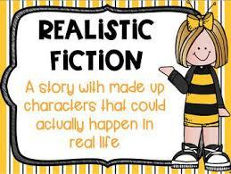

Slide 21
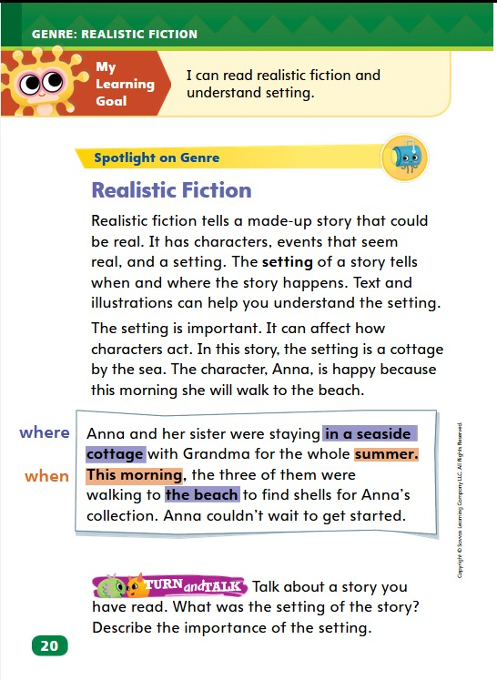

Slide 22

a) What is realistic fiction?
A) Stories about talking animals
B) Stories that take place in outer space
C) Stories that could happen in real life
D) Stories with magical creature
b) Which of the following is an example of realistic fiction?
A) A story about a flying unicorn
B) A story about a super hero who can turn invisible
C) A story about a girl who makes new friends at school
D) A story about a dragon who lives in a castle

Slide 23

C) Realistic fiction stories are mostly about:
A) Adventures in a magical land
B) Dinosaurs living in modern cities
C) Things that could really happen
D) Robots taking over the world
d) What makes a story realistic fiction?
A) Lots of pictures in the book
B) Made-up characters and places
C) Events that could happen in real life
D) Talking animals as the main character

Slide 24
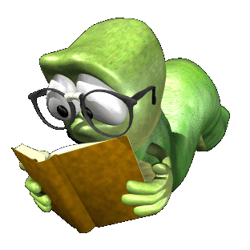
Happy Reading!!!

Slide 25
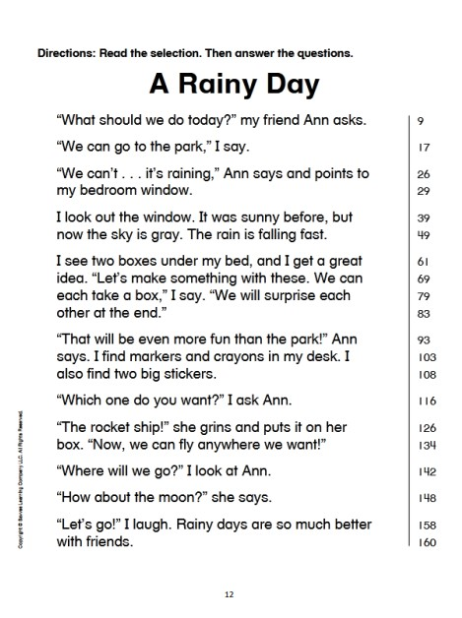

Slide 26
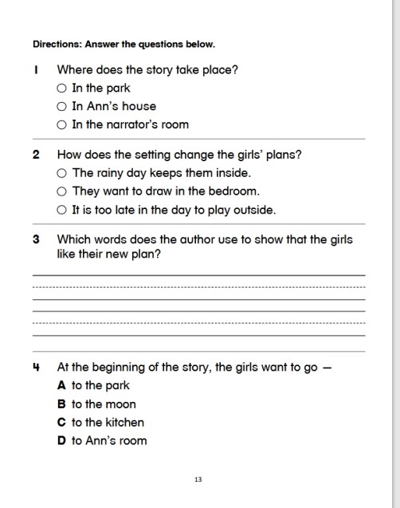
Rainy days are so much better with friends.

Slide 27
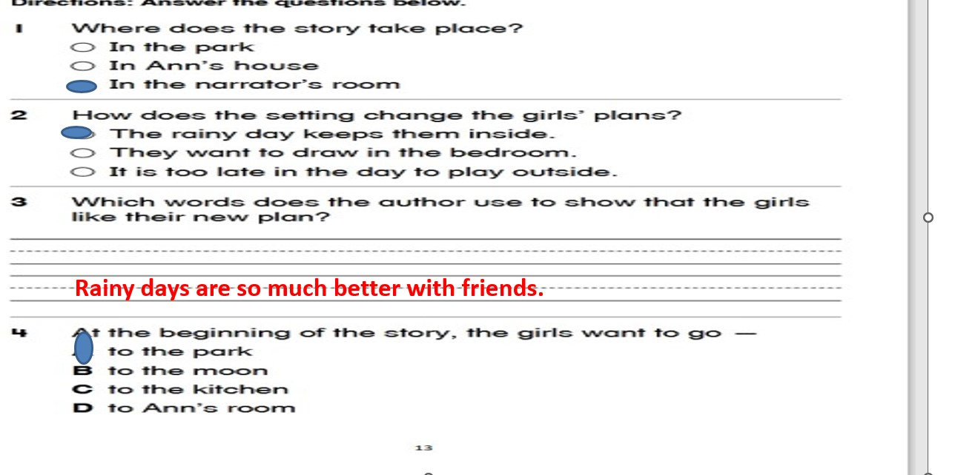

Slide 28


